Slide 1
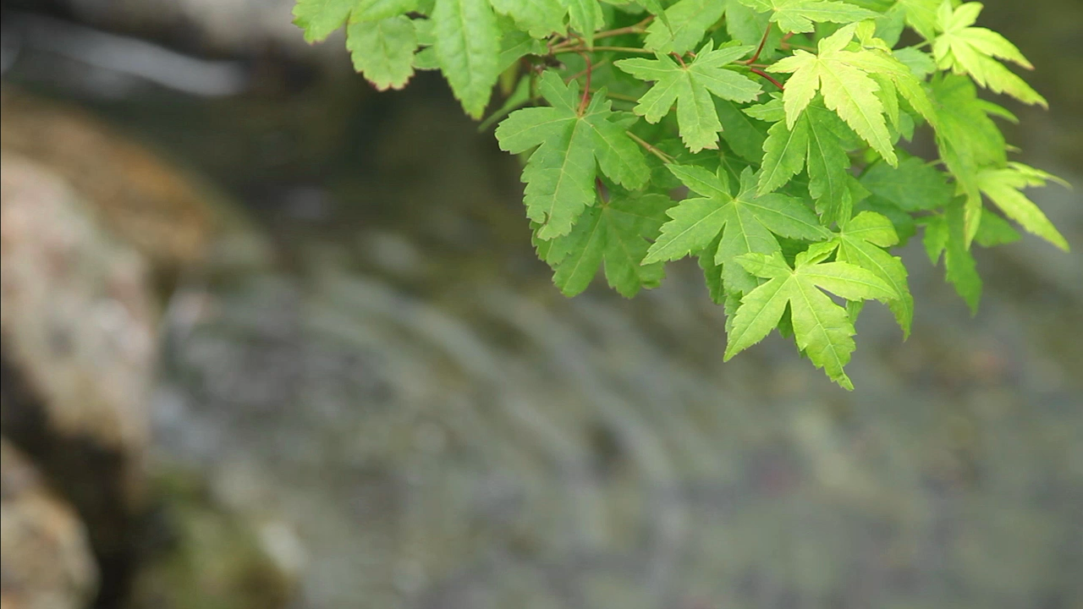
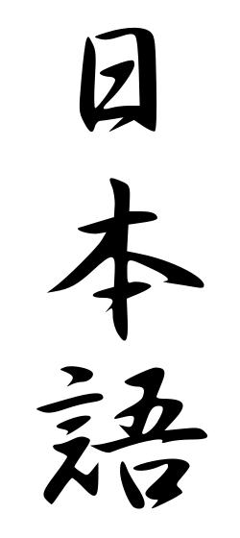
Japanese
日本語 (Nihongo)
Notes:
Minna-san! Konnichiwa! Watashi wa Usha desu!
Hello everyone! I’m Usha.
Kyou no nihongo session o go-shokai sasete itadakimasu.
I’m pleased to present today’s session on Japanese.
Nihon no kuni wa totemo tanoshikute, yasashikute, omoshiroi kuni desu. Nihon ni wa utsukushī mono ga takusan arimasu. Nihongo mo utsukushi-sa to imi ni michita gengo desu.
Japan is a kind, exciting and beautiful country. And Japanese language is just as full of beauty and meaning.
Douzo yoroshiku onegaishimasu!
Thank you very much!

Slide 2
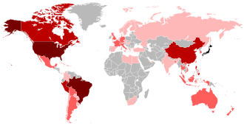
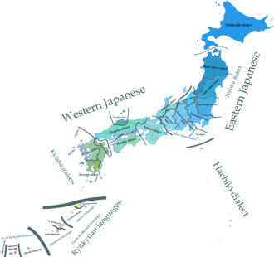
Where will I find Japanese spoken?
Japanese is the official language of Japan (of course!)
Immigrants took it where they went – places like Brazil, Hawaii, Peru, Philippines during the Meiji period (late 19th century) and elsewhere after that.
125 million native speakers
Japonic language family. Two well-defined branches: Japanese and Ryukyuan
“Japanese has been subject to more attempts to show its relation to other languages than any other language in the world.” – Martine Irma Robbeets No clear relation with any other language group so far.
Images from Wikimedia

Slide 3
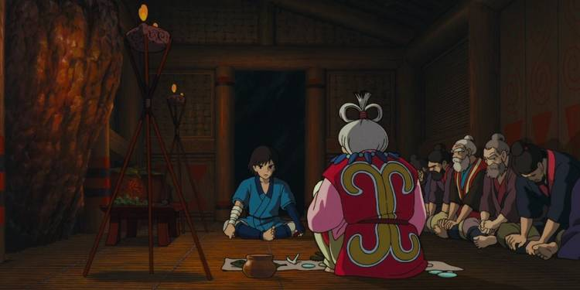
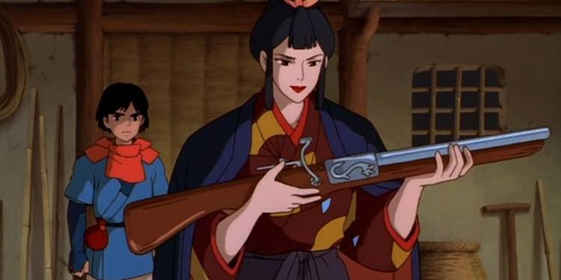
Japan – a melting pot over ages
Scholars are not entirely agreed on the timelines how people migrated in and settled across Japan.
Paleolithic tools were found from after the last Ice Age. Jomon culture (13000-1000 BC, marked by world’s oldest ceramics) are said to have been hunter-gatherers who lived in small communities. Agricultural Yayoi culture (1000-800 BC? 500-300 BC?) brought in rice cultivation and iron-making.
The spirit of what this melting pot could have been is, for me, probably captured nicely in the movie Princess Mononoke with Ainu/Jomon-influenced Emishi Prince Ashitaka and Yamato-influenced Lady Eboshi.
This ethos of ideas coming in from elsewhere, adapting in to suit their new homeland and then transforming into new uniquely Japanese ideas has always been there through the ages.
Copyright: Studio Ghibli and CBR, https://www.cbr.com/princess-mononoke-themes/

Slide 4
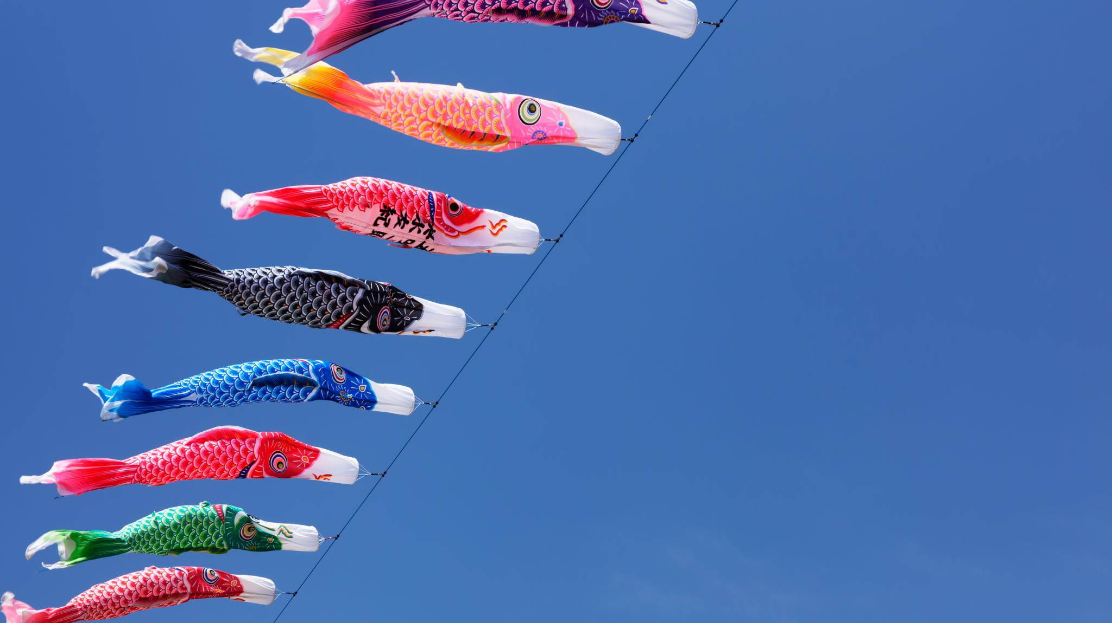
Japanese Language

Slide 5
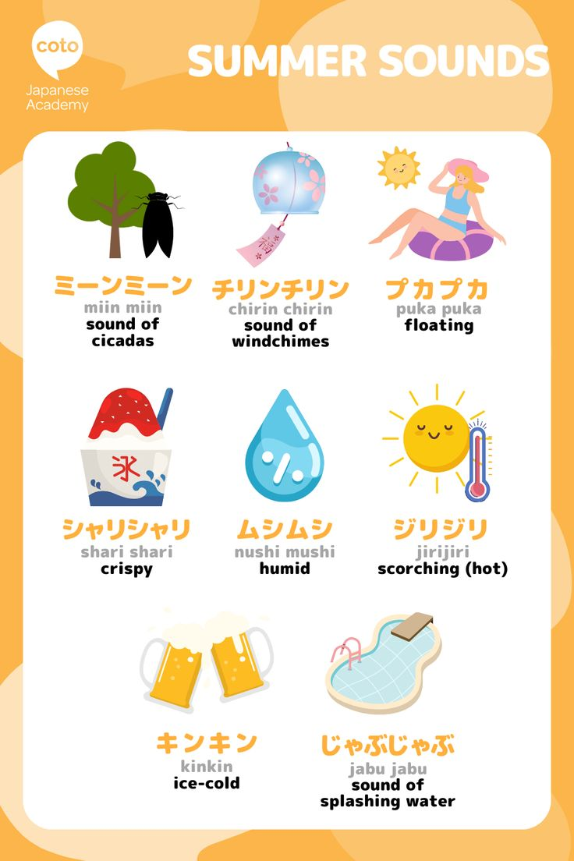
Characteristics of Spoken Japanese
Relatively simple phonetics
Mostly vowel and consonant+vowel (ka, sa, chi, ri ) sounds except for n. Mora-timed. Sounds flowing and pleasant to the ear.
Homophones are very common. Context is key to deciphering.
(漢字- kanji, 感じ - feeling)
Onomatopoeias and sound repetitions are common
(pika-pika, peko-peko, doki-doki and hito-bito, toki-doki)
Pitch-accent is present though you can get by without it (mark of gaijin tourists like myself…) unlike stricter Chinese or Vietnamese.
Keigo - based on levels of politeness, there are different ways to say something if you are senior, junior, male, female, with office colleagues, with friends, with your supervisors, in public, in private, with yourself, and so on….
Copyright: Cota Japanese Academy

Slide 6
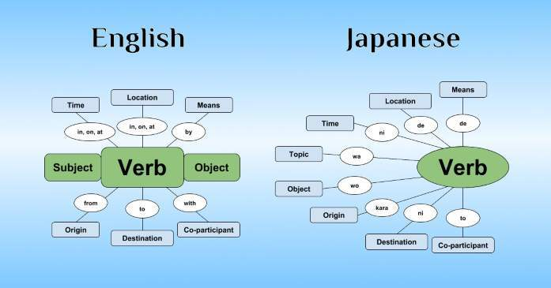
Characteristics of Japanese Grammar
Agglutinative with suffixes, prefixes, roots remain mostly unchanged.
No plurals/genders for noun, no articles (I’m looking at you, French, robber of my high school peace!)
Sentence structure is usually Subject-Object-Verb with particles acting as glue. Subject is often dropped.
Verbs are conjugated to get past/present/past perfect/present continuing/permission (not so different from French here, sigh…)
Very expressive, nuances can convey a wide range of feelings.
Copyright: 80/20 Japanese

Slide 7
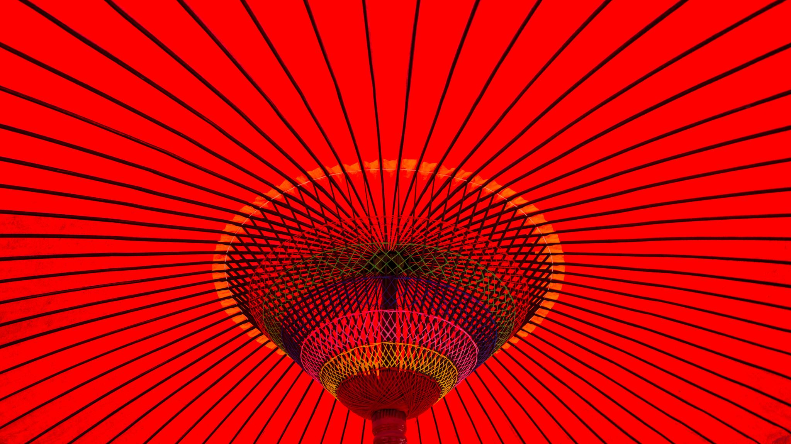
Japanese Writing
3 different “scripts”
Kanji
Kana
- Hiragana
- Katakana

Slide 8
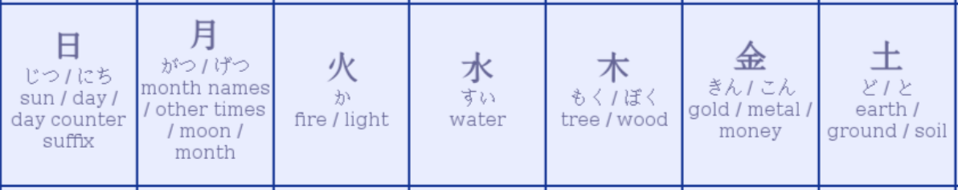

Kanji
Adopted Chinese characters
5th-9th century
Logograms/pictographic – a character represents a word/concept/semantic unit.
The character can be used via on’yomi (Sino-Japanese reading) or kun’yomi (Native reading)
学校 - gakkou (school), 学ぶ - manabu (study)
Can combine to form new meanings
電話 – denwa (telephone) – electric talking!
No definitive count (~50,000 characters in official dictionary)
~2000 characters for functional literacy, ~3000-4000 characters in regular usage

Slide 9
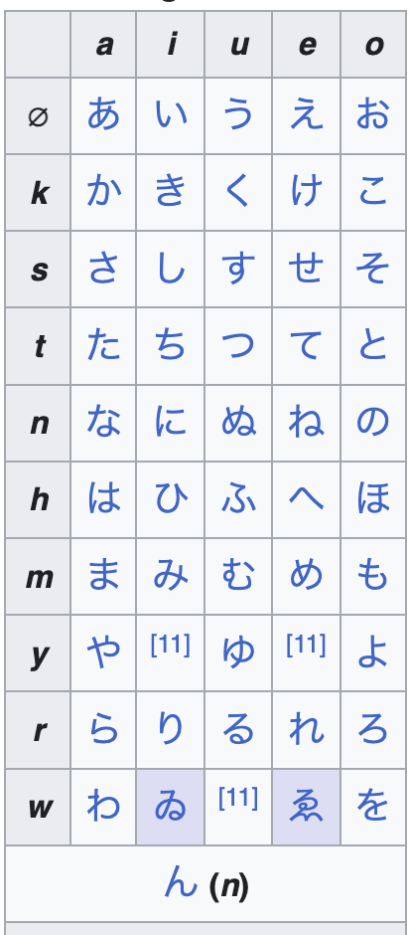
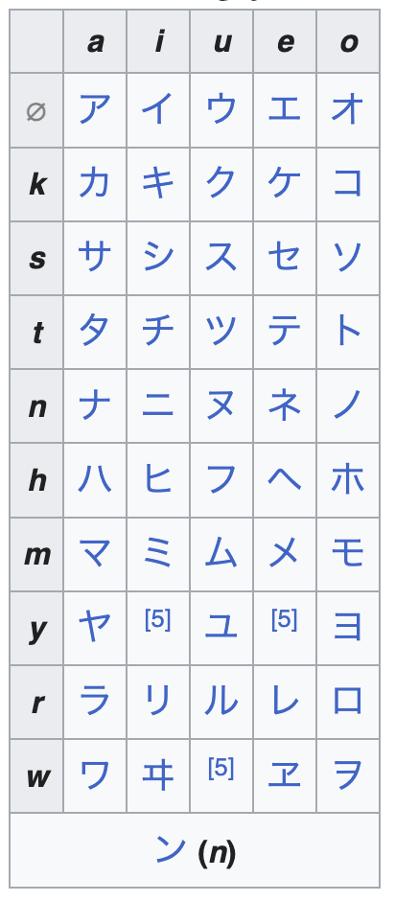
Kana
Phonetic
48 base characters
Hiragana
Cursive and simple form of kanji, dates from 9th century
Back in the Heian period, was considered “women’s writing” while kanji was considered “educated men’s writing”. Widely used in court writing by women, this is the language of the Tale of Genji.
Used for grammatical functions and native words, also as reading aids for kanji
Children’s books and regular rescuer of gaijin tourists….
Katakana
Fragments of kanji
Hard/angular looking
Evolved from Buddhist monks translating Chinese texts with Sanskrit words into Japanese
Now used for foreign-language loan words and onomatopoeia (more than you’d would think) – terebi, noto, sakka, isukirimu, makudonarado!
Hiragana
Katakana

Slide 10
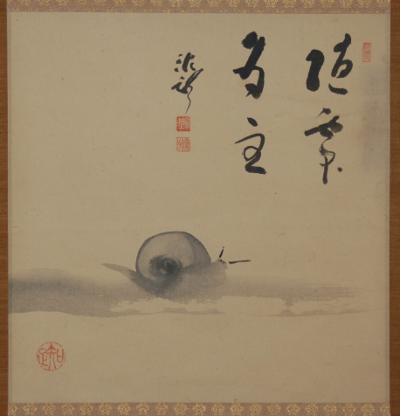
Together….
コンピューターを使うのが好きです.
Conpyuta o tsukau no ga suki desu.
I like using computers!
隨處 為主
Find yourself where you go.
Kanshu Sojun (1895-1954)

Slide 11
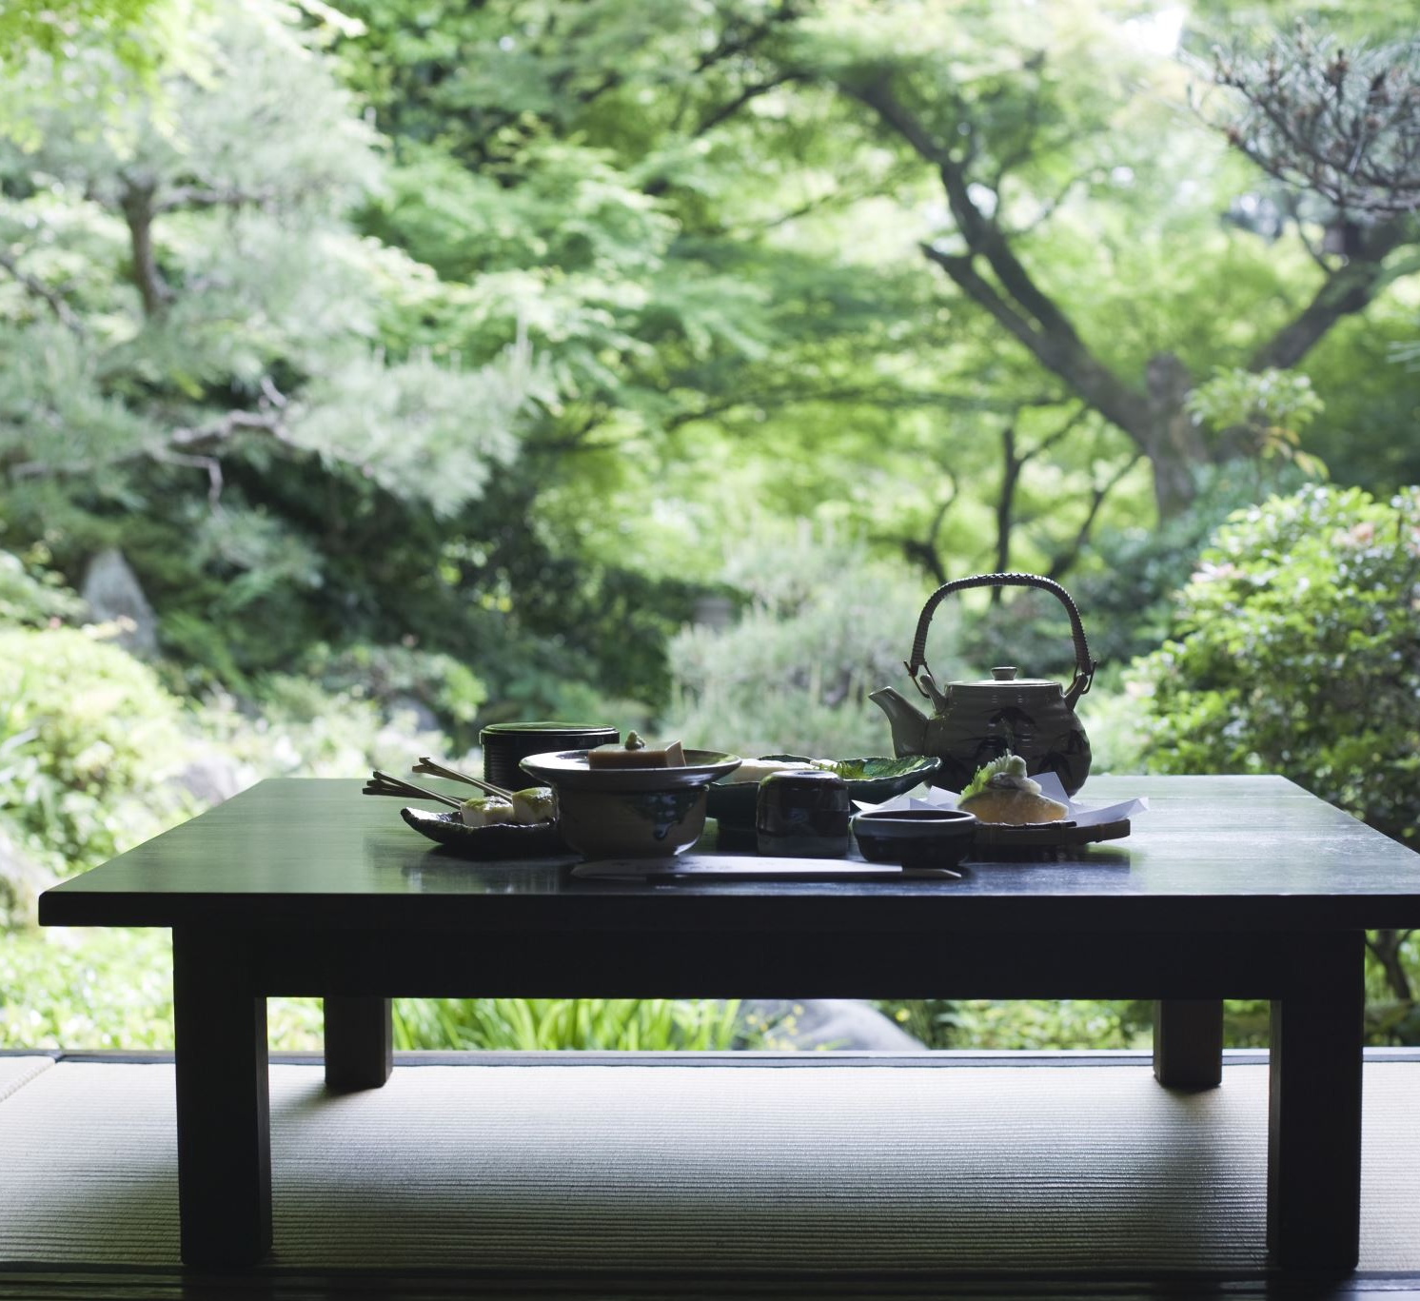
Thank you for listening!
Notes:
iro iro o sewa ni narimashita ne! Aarigato gozaimashita!
Thank you all for listening!

